Slide 1
Improving the accuracy of protein secondary structure prediction using structural alignment
Scott Montgomerie, Shan Sundararaj, Warren J Gallin and David S Wishart
BMC Bioinformatics 2006, Vol. 7, Num. 301
Presenter: Yung-Hsing Peng
Date: Nov. 23, 2006

Slide 2
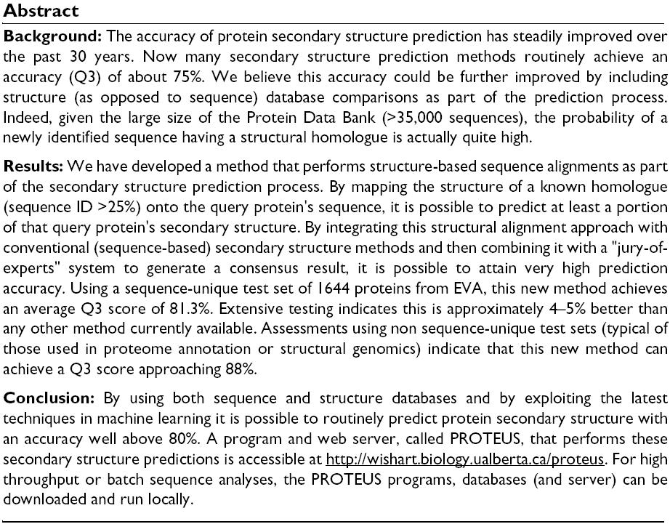

Slide 3
Main Idea
Homology-based prediction of protein secondary structure is accurate when sequence identity is greater than 30%, but inaccurate with low sequence identity.
Neural networks can be used to train a prediction system.
The authors proposed the method called “PROTEUS”, which combines the idea of “jury of experts” with homology-based prediction (through neural networks).
The database of secondary structures is called PROTEUS-2D, which is produced by applying a 3D-to-2D procedure (called VADAR) on PDB.

Slide 4
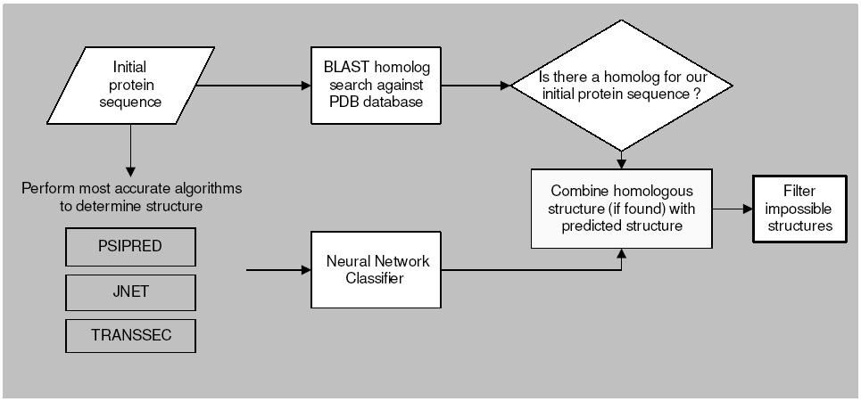
Flow Chart (1/2)
The homologues with ID > 30% can be detected by a sliding window of size W=7 on the result of BLAST search. The secondary structure of the middle residue (target residue) in the window will be predicted according to confidence scores.
jury of experts

Slide 5
Confidence Score
Confidence score (CS) ranges from 3 to 9.
(1) Prediction with homologues: CS=9 if ID >30%, else CS=8.
(2) Prediction from jury of experts: CS ranges from 3 to 9
If (1) and (2) both yield the same confidence score, target residue will be assigned the secondary structure predicted in (1).

Slide 6
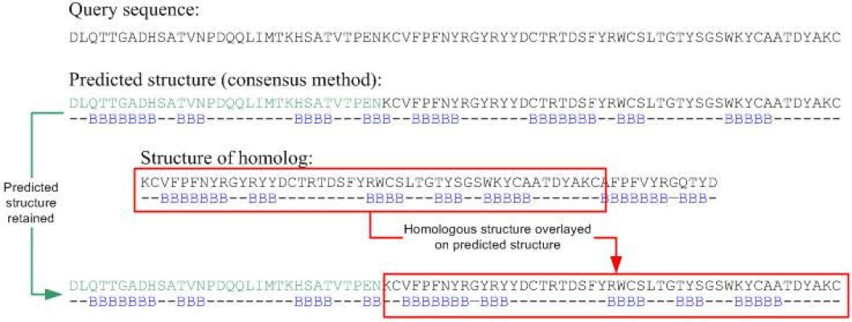
Flow Chart (2/2)

Slide 7
Computing the Accuracy
There are two typical methods to measure the performance of the prediction for a secondary structure.
(1) The Q3 score (based on number of matches)
(2) The SOV score (sensitive on overlapping segments)
Given two secondary structures CHHHHC and CHHCHH, their Q3 score is 4/6 = 0.667
Next, we will take a look at the SOV score.

Slide 8
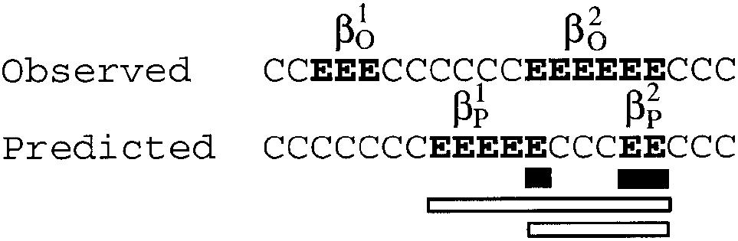
Parameters in SOV
minov(O₂,P₁)
minov(O₂,P₂)
maxov(O₂,P₁)
maxov(O₂,P₂)

Slide 9
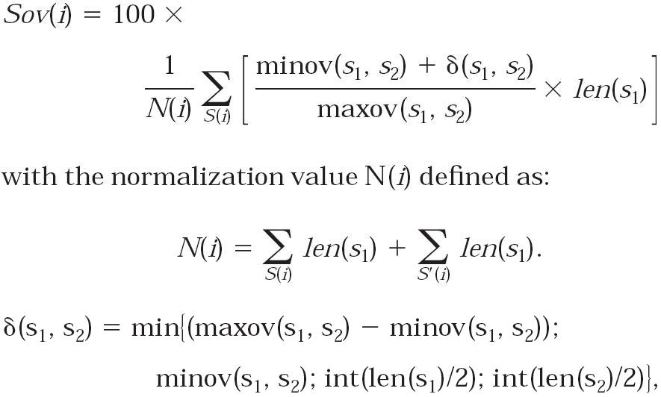
Formulas of SOV
0 ≤ R ≤ 1
When s1 highly overlaps with s2, R will be 1.

Slide 10
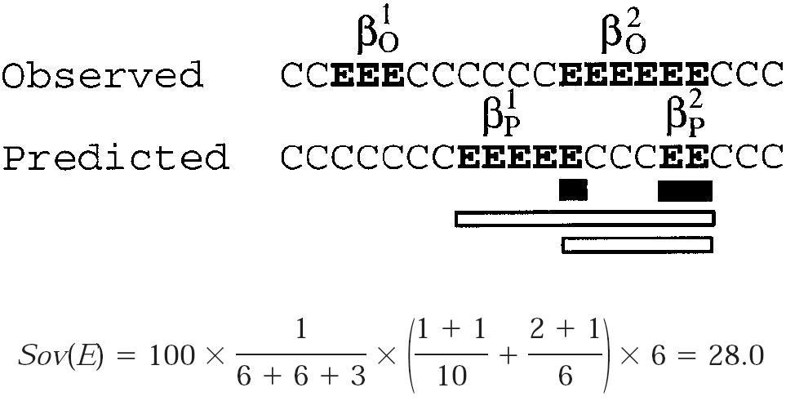
Example for Computing SOV

Slide 11
Experiments (1/4)
The authors experimented PROTEUS with four different kinds of data set
(1) The PROTEUS-2D database (leave-one-out with 100 training data)
(2) The non-homologous dataset (1664 proteins from PDB, ID<33% with W=100)
(3) 125 randomly selected proteins in PDB, which were recently solved by X-ray.
(4) Versus well-known prediction servers with 10 recently solved protein.
In experiment (1), PROTEUS achieves average Q3=88% and SOV=86.5%, which are 10~15% higher than other methods.

Slide 12
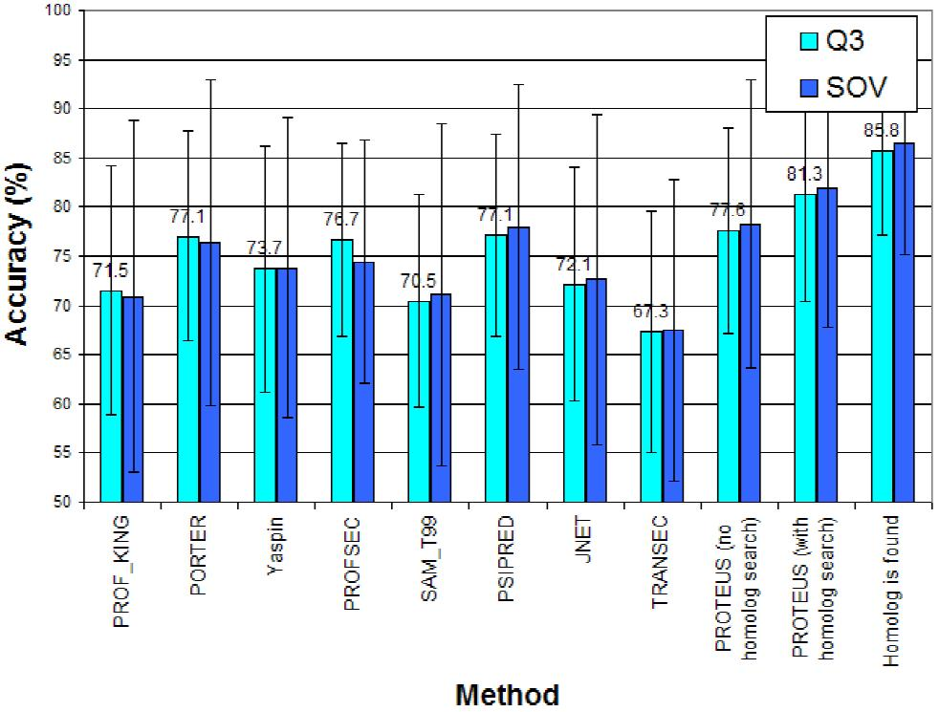
Experimental Results (2/4)
Results of experiment (2)

Slide 13
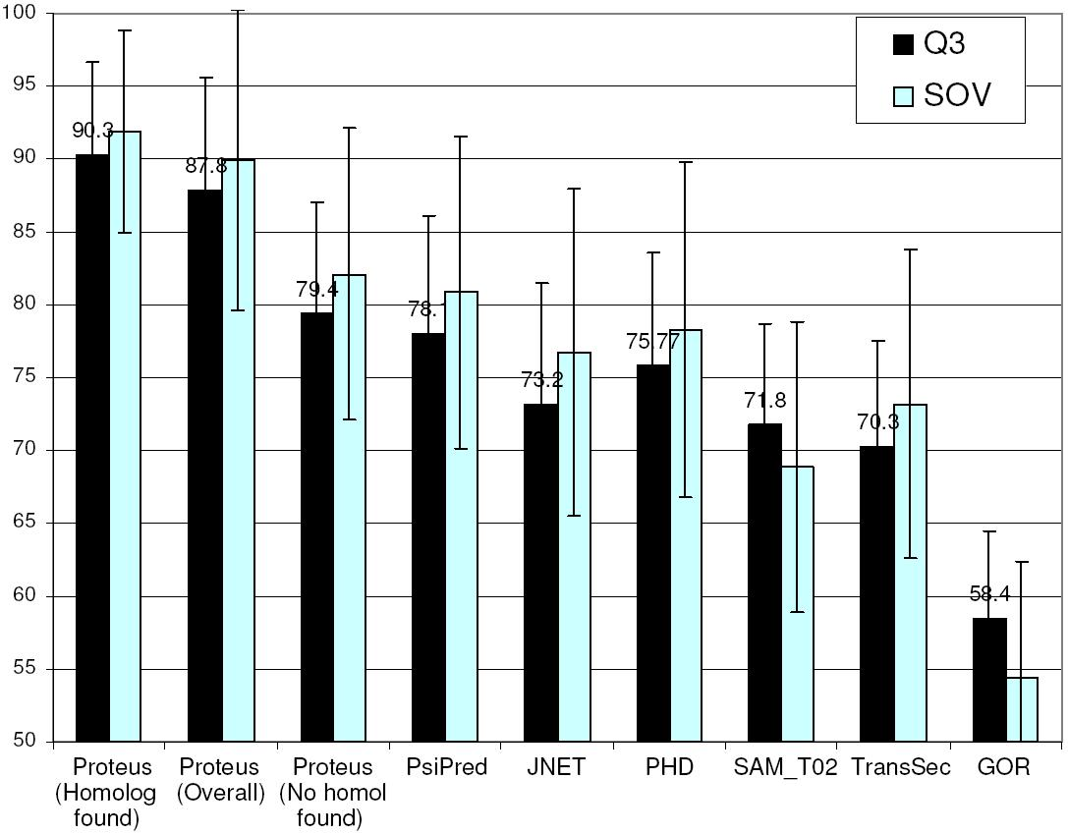
Experimental Results (3/4)
Results of experiment (3)

Slide 14
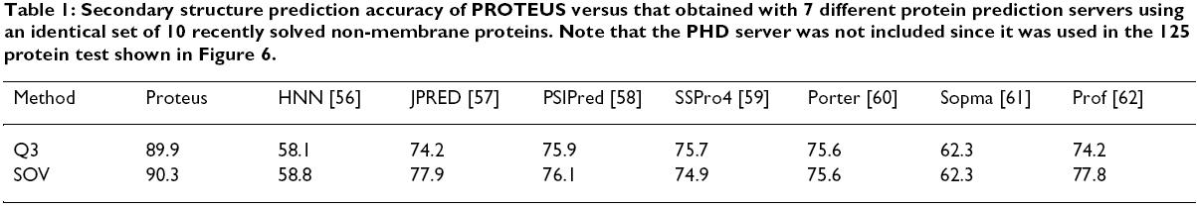
Experimental Results (4/4)
Results of experiment (4)
From experiments (1)~(4), the authors concluded that PROTEUS is, in average, 4~5% more accurate than previous methods.

